Slide 1
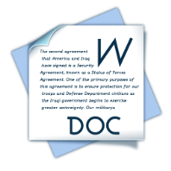
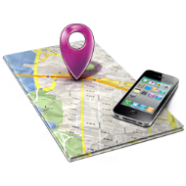
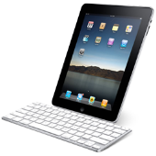
SAMR Model
Substitution
Augmentation
Modification
Redefinition
Students use a word processor for their writing. Students can now easily edit and format their writing.
Published work is now printed rather than handwritten. Students can save various drafts of their work.
Students search the internet for information to support their persuasive topic.
Students improve their writing through the tools within the word processing program e.g. spelling, grammar check, thesaurus, word count.
Images and graphics are easily embedded within the document.
Students can email external sources for further information.
Teacher shifts the focus of some of the writing task to be collaborative.
Students use an online collaborative space (e.g. wiki) to write in small groups, conduct peer editing and feedback, and to comment on final products.
Work can be done in class time, as well as out of class.
Teacher chooses to collaborate with other classes locally or globally on a common issue, using video-conferencing.
Students research and share their findings within a virtual classroom, in order to find a common solution. The project uses the strengths of students from different classes.
Students use a range of multimedia to collect, communicate and distribute their findings and conclusions

